Slide 1
Smart Contract Testing
Source of some materials:
Xiwei Xu, Ingo Weber, and Mark Staples. Architecture for Blockchain Applications. Springer, 2019

Slide 2
Outline
Importance of testing
Types of testing
Common vulnerabilities & solutions
Tools & techniques
Notes:
We’ll discuss what it is important to test smart contracts or any software for that matter.
Then different types of testing are introduced.
We discuss a common set of vulnerabilities and solutions before we talk about tools and techniques for smart contract testing.

Slide 3
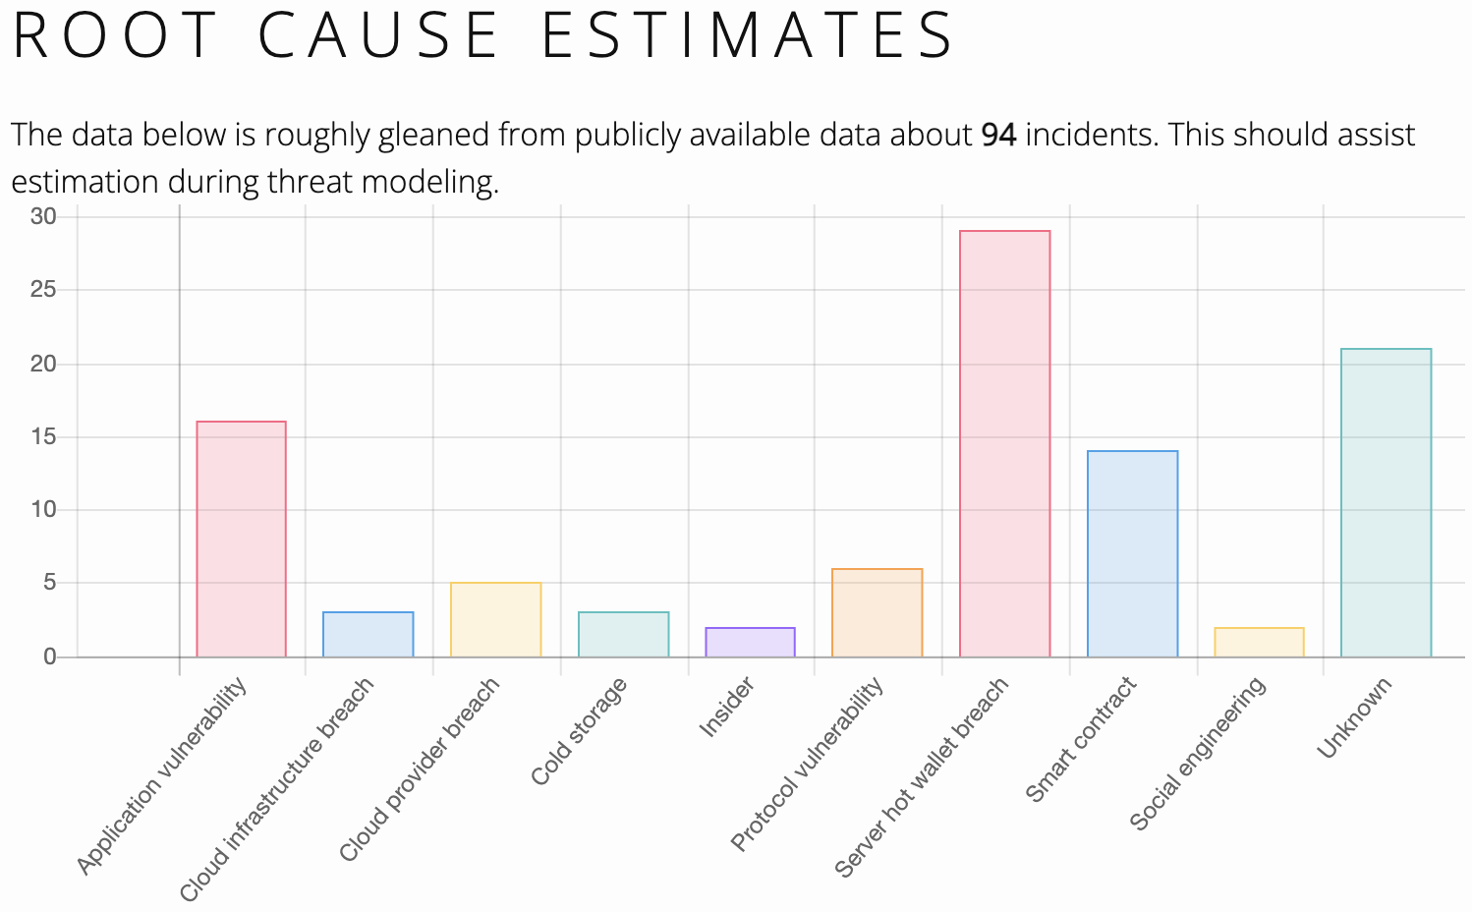
Failures in Blockchains are Permanent & Catastrophic
Source: https://magoo.github.io/Blockchain-Graveyard/
Notes:
Failures in blockchains are permanent and catastrophic.
Here are some statistics from a website called Blockchain Graveyard.
We can see the application and smart contract vulnerabilities, as well as how you manage keys are key sources of attacks.
More frighteningly, we don’t even know what took place. Those are under “unknowns”.
There are also issues around system-level vulnerabilities like protocol and cloud vulnerabilities.
To guard against these issues:
First, we need to build secure software and infrastructure.
Then we should test them.

Slide 4
Scope of Blockchain-Based Applications Security
Smart contracts
Blockchain platform
Consensus
Smart contract language & execution-environment
Cryptography
DApp architecture
Integration with external systems
Data management
Cryptography & Key management
Access control & KYC
Privacy
Infrastructure, especially for private blockchains
Business continuity & disaster recovery
Governance & compliance
Notes:
Therefore, to make sure a blockchain-based application is secure we need a conduct a large set of tests. What specific tests and depth of testing can depend on the importance of the application. Typically, the final phase of testing is done by a 3rd party.
When we think about blockchain security, most people only consider smart contract security. Security testing of smart contracts includes both code-level testing and run-time testing.
In this class, we’ll focus mostly on smart contract testing.
But as we saw from the previous graph, to make sure a blockchain-based application is secure, we need to make sure many aspects/components of the system are secure.
This is ensured by secure design and extensive testing. What specific tests and depth of testing can depend on the importance of the application.
The choice of the blockchain platform is the main consideration. The key focus should be the blockchain platform’s consensus mechanism, its use of cryptography, and smart contract language and execution environment
If the blockchain platform is well-established and time-tested you have some level of assurance and a good understanding of how it works.
If it’s a new platform, then you need to review and test everything from its design, protocols, and smart contract execution environment.
Software architecture should be designed to achieve security (i.e., secure by design). Architecture testing is a qualitative review of the design to determine its soundness in dealing with potential security issues.
While typical architecture reviews consider security as a non-functional requirement, there should be a separate detailed review focusing only on security.
Integration with external systems, how we manage data, cryptography and key management, access control and KYC, and privacy are other design considerations. They can also be tested once developed.
We should choose, configure, and test the infrastructure chosen to host the blockchain and other components of the application. This is particularly important for private blockchains.
Business continuity and disaster recovery are also important. If you are hosting the blockchain platform you need to think about the number of nodes and where they are located to enhance availability.
Blockchain governance is all about how you manage the platform from the addition of a new node and users, updating smart contracts to who pay for what and how issues are resolved.
If your application needs to comply with certain regulations, then you may also have some reporting requirements to show compliance. While some authority may run a node, you may still have other obligations to ensure you design the system considering such compliance needs and continue to operate satisfying these compliance needs.
KYC – Know Your Customer

Slide 5
Types of Software Testing
Software Testing
Static
Byte code
Dynamic
White box
Black box
Source code
Notes:
There are several classifications of software testing. Here’s one way, that I would consider more relevant to smart contracts.
Another form of classification is functional and non-functional testing.
Static testing - is a class of methods that examine the source code or bytecode of a contract without executing it. Essentially code testing.
Source code – use code as it is. Typically IDEs (e.g., Remix) give various hints as you write code. Or evaluated at the time of compilation.
Byte code – Use the compiled code, e.g., when multiple high-level languages can generate the same byte code.
Dynamic testing – observes a contract while executing it in a test or production environment. Essentially, it is run-time testing.
White box testing – You know code or international functionality.
Black box testing – Only ABI is available so you know the functions and parameters.
Unit testing and integration testing are forms of dynamic testing as we execute the code.

Slide 6
SC Security Testing Solutions
Source: Di Angelo, M., & Salzer, G. (2019, April). A survey of tools for analyzing Ethereum smart contracts. In 2019 IEEE Int. Conf. on Decentralized Applications and Infrastructures (DAPPCON).
Notes:
Here’s a table from a survey of testing tools for Ethereum smart contracts.
Each row is a tool. Columns are grouped based on their purpose of testing (or objective) whether the test is performed based on bytecode or source code.
It also split the testing based on the target, e.g., whether it’s testing the blockchain platform, EVM, or the source code. Source code testing may happen at the bytecode.
You can see that Remix-IDE has good coverage of tests.
However, this doesn’t mean that you are covered against all possible vulnerabilities or even more complex cases of these vulnerabilities. Hence, more detailed and widespread testing is needed.
Note that most tests are based on static testing and dynamic testing tools are less common.
Some tools will translate or convert either byte or source code to another intermediate language that is easier to analyse using formal techniques.
The paper is on Moodle. I would encourage you to have a look as it’s not very difficult to read.

Slide 7
Common Vulnerabilities & Solutions
Notes:
Let’s focus a bit on some of the common vulnerabilities and hoe we can overcome them
We have already discussed a couple of these issues do different extent through the course

Slide 8
Known Issues/Vulnerabilities in Smart Contracts
Race conditions
Reentrancy
Cross-function race conditions
Deadlocks
Denial of Service (DoS)
Unexpected throw
Gas limit
Block & TX limits
Arithmetic overflow/underflow
TX order dependence (front running)
Timestamp & block no dependence
Random no
Access control
Ability to call selfdestruct()
Bad error handling
Language-specific behaviour
Not setting owner of a contract
Depreciated functions
Short address attack in EVM
Call stack depth
Notes:
These are many well-known issues in smart contracts. In the next couple of slides, we will discuss the ones in blue.
A race condition occurs when more than one piece of code tries to update the same ledger state concurrently.
Race conditions occur when 2 or more functions try to update the state and the final result depends on which function runs last.
Re-entrancy attack occurs when you call another smart contract, which can call your contract again to access its state.
Deadlocks could make a smart contract unusable though it is not destroyed, e.g., the contract gets stuck at some state.
Denial of Service is possible when you do not properly handle errors or due to the block gas limit. We will talk about a few examples.
Arithmetic overflow and underflow of variables is another problem where numbers stored in variables overflow and underflow.
There can be unintended behaviour when your smart contract is sensitive to transaction orders. One such example is front running.
There are issues about the use of time. One thing is block timestamp is not reliable. Another is if others know (by looking at your smart contract and its code), that you are planning to do something at a specific block number or hash of that block, miners could try to build a block with specific properties to make use of your contract.
Not doing proper access control could allow others to run away with crypto or destroy your contract by calling the selfdestruct function.
Due to bad error handling you may open up vulnerabilities that others may take advantage of or it could lead to a deadlock.
There can also be smart contract language-specific issues:
E.g., if you forget to set the owner of a smart contract anyone can change its state.
Also, the use of depreciated functions is another problem, which can go unnoticed depending on the Solidity compiler version you use.
There were specific issues related to how EVM handle certain addresses and limits on function depth.
Now that you know these, you should definitely try to check for them. There can also be many others that are specific to a given smart contract. Hence, you need to check for those are well.

Slide 9
Reentrancy
mapping (address => uint) private userBalances;
function withdrawBalance() public {
uint amountToWithdraw = userBalances[msg.sender];
(bool success, ) =
msg.sender.call.value(amountToWithdraw)("");
require(success);
userBalances[msg.sender] = 0;
}
withdrawBalance
msg.sender.call()
Source: https://github.com/Consensys/smart-contract-best-practices/blob/master/docs/attacks/reentrancy.md
Notes:
This is an example of re-entrancy within a single function in Solidity. This is what took place in The DAO attack.
This contract allows the msg.sender to withdraw its ETH balance.
It first finds the balance and tries to transfer the ETH balance to the msg.send’s address using call.value function.
When you use the call function, you may be calling another contract, which in turn may call your withdrawBalance function again. As you still have a balance, this will lead to another call to that contract, which may call withdrawBalance again, forming a loop.
Once the loop is broken, you end up transferring the amount to withdraw multiple times.
There are at least 2 ways to fix this:
We need to move the line that set the user balance to zero before the call.value. That way, even if that called contract calls you back, the balance is zero. Hence, they can’t withdraw anything more than what they had as a balance.
An alternative fix is to use a withdraw function (a new function) to get the receiver to pull the crypto than us pushing the funds.
Reentrancy can happen across multiple functions too.

Slide 10
Cross Function Reentrancy
mapping (address => uint) private userBalances;
mapping (address => bool) private claimedBonus;
mapping (address => uint) private rewardsForA;
function withdrawReward(address recipient) public {
uint amountToWithdraw = rewardsForA[recipient];
rewardsForA[recipient] = 0;
(bool success, ) = recipient.call.value(amountToWithdraw)("");
require(success);
}
function getFirstWithdrawalBonus(address recipient) public {
require(!claimedBonus[recipient]);
rewardsForA[recipient] += 100;
withdrawReward(recipient);
claimedBonus[recipient] = true;
}
Source: https://github.com/Consensys/smart-contract-best-practices/blob/master/docs/attacks/reentrancy.md
Notes:
Here’s another example where just setting balance before call won’t work.
The withdrawReward function is fixed to overcome reentrancy issue.
However, it can be called within getFirstWithdrawalBonus function, where for the 1st withdrawal you get a bonus.
While the call.value is pending you can call getFirstWithdrawalBonus function.
In this case, before calling the withdraw function claimedBonus need to be set to True.
Another potential solution is to use a mutex.

Slide 11
Front-Running
Header
Buy 1000 XYZ Token
Buy 1000 XYZ Token
Sell 1000 XYZ Token
All TXs are visible while they wait in the TX pool
Waiting time varies from seconds to hours
An adversary can issue a TX with a much higher TX fee
Displacement – Bidding, crypto exchanges, registering a domain name
Insertion – Seeing a buy order, buy first & sell immediately at a higher price (aka sandwich attack)
Suppression – Slowing others down
Solutions
Restructure SCs such that order or time is not a factor that determines outcome
Commit & reveal, e.g., hash lock
Zero-knowledge protocols
See: https://github.com/Consensys/smart-contract-best-practices/blob/master/docs/attacks/frontrunning.md
Notes:
Frontrunning issue occurs because all transactions are visible to anyone while they await in the transaction pool.
Waiting time could vary from a few seconds to many hours. In the meantime, others can see what your transaction is planning to do and adapt their transactions.
An adversary has a good chance of getting his/her transaction included before yours if they offer to pay a (much) higher transaction fee than yours. Even if they don’t offer a high transaction fee, they can do by colluding with miners who may be successful in building a block with adversarial transactions before your transaction is included in a block.
Miners may do this on their own too. Gains from suck attacks are called miner extracted value (MEV).
There are several scenarios here:
Displacement – where the adversary replaces your transaction with his/her transaction by outbidding you. This can be a problem in bidding, crypt exchanges (particularly distributed ones), and registering for resources like domain names.
Insertion - Adversary insets one or more TXs before your transaction. E.g., knowing that you are interested in buying something big, they can buy that first and immediately sell it to you at a profit. Sometimes you can even see these adversarial transactions are sandwiched between a legitimate transaction.
Suppression - adversary’s objective is to slow you down. They can do this by submitting large and high fee-paying transactions.
Potential solutions include:
Modifying your smart contract such that it doesn’t depend on order or time of transactions. This is not always possible.
In such cases, you can use solutions like commit and reversal or even zero-knowledge proofs. The idea is to hide sensitive information until the desired result is achieved. E.g., you may commit to buying something at a set price. Based on this you send a hash value. Later revealing the actual price such that the smart contract can check with the previous hash.
Ethereum is planning to encrypt the transaction pool and also the transfer of transactions between 2 nodes.

Slide 12
Arithmetic Overflow/Underflow
mapping (address => uint256) public balanceOf;
function transfer(address _to, uint256 _value) {
require(balanceOf[msg.sender] >= _value);
balanceOf[msg.sender] -= _value;
balanceOf[_to] += _value;
}
Another solution is to use SafeMath.sol library
function transfer(address _to, uint256 _value) {
require(balanceOf[msg.sender] >= _value &&
balanceOf[_to] + _value >= balanceOf[_to]);
balanceOf[msg.sender] -= _value;
balanceOf[_to] += _value;
}
Source: https://github.com/Consensys/smart-contract-best-practices/blob/master/docs/attacks/insecure-arithmetic.md
Notes:
This is the usual case of over or underflowing a variable.
Also, be aware this can happen with ++, --, *, /, and bit shift operations
Be careful with the smaller data types like uint8, uint16, uint24…etc: they can even more easily hit their maximum value.
The solution is to check if the sender has a balance and for overflows at the receiver.
Another solution is to rely on a library like SafeMath that performs these checks for you.

Slide 13
Timestamp Dependence
Miners can manipulate block timestamps to some extent
Inter-block time can substantially vary
Avoid using block.timestamp or block.number x inter-block time
Even block.number isn’t future proof
Solutions
Design SC to not rely on time
Use oracle as a time source
See: https://github.com/Consensys/smart-contract-best-practices/blob/master/docs/development-recommendations/solidity-specific/timestamp-dependence.md
Notes:
It is unsafe to decide the execution of your smart contract based on time as miners can manipulate block timestamps to some extent.
If the reward of manipulating time is high, miners may even put additional computing power to set the timestamp to a value favourable to the miner.
Also, estimating time based on inter-block time is risky.
Hence, it’s not a good idea to use either block.timestamp or even block.number x inter-block time (e.g., in Ethereum block.number x 12 sec)
Even block.number is not very future-safe to guard against significant changes in mining difficulty or inter-block time. For e.g., say Ethereum suddenly decide to reduce inter-block time to 5 sec, as they have already gone down from 13 to 15 sec to 12 sec.
The best solution is not to rely on time.
Another option is to rely on an external time source via an oracle. This way we can rely on physical time. Of course, we are trusting the oracle.

Slide 14
Denial of Service (DoS)
contract Auction {
address currentLeader;
uint highestBid;
function bid() payable {
require(msg.value > highestBid);
require(currentLeader.send(highestBid));
currentLeader = msg.sender;
highestBid = msg.value;
}
}
Source: https://github.com/Consensys/smart-contract-best-practices/blob/master/docs/attacks/denial-of-service.md
Notes:
Your smart contract can get stuck due to a bug in code or some odd sequence of function calls that you didn’t anticipate.
Here’s a bidding smart contract that refunds the previous highest bidder’s Ether as soon as a better bid arrives.
Refund the old leader, if it fails then revert
The fallback function on the old leader can be set to revert any payments. If so, 2nd line will fail, reverting the transaction.
A malicious bidder can become the leader while making sure that any refunds to their address will always fail → That bidder will always be the highest bidder.
This is a denial of service to other potential bidders.

Slide 15
DoS (Cont.)
address[] private refundAddresses;
mapping (address => uint) public refunds;
function refundAll() public {
for(uint x; x < refundAddresses.length; x++) {
require(refundAddresses[x].send(refunds[refundAddresses[x]]))
}
}
Solutions
Pull refund than push
Limit no of accounts
Break the loop into multiple TXs
Notes:
Here’s another example that can go wrong in 2 ways.
Because of the require statement, if one participant rejects/fails, the rest of the participants can’t get a payout.
Also, if the payee list is too large, gas used by refundAll function may exceed the transaction gas limit.
Attackers could also deposit small amounts from a large number of accounts.
Potential solutions include the use of withdraw function with a pull.
Also, we can prevent the use of a large number of accounts by setting a limit of minimum amount or even limiting the no of accounts.
We can also break the loop into multiple transactions, e.g., rather than refunding to 100 accounts, we can get someone to issue 10 transactions such that each transaction refund to 10 accounts.

Slide 16
Random Number Generation
Typical rand() won’t generate same random no across all blockchain nodes
Use of block.timestamp, block.number, block.difficulty, block.hash as random seed is too predictable or could be manipulated
Solutions
Use an oracle to provide random value
Using an external commitment scheme with a smart contract, e.g. RANDAO
Notes:
Random numbers are useful in many contracts, e.g., lottery and gambling contracts.
We can’t use typical the rand() function available in most languages as different nodes will generate different random values → transaction fail to validate.
While values like block.timestamp, block.number, block.difficulty, block.hash could be used to set the seed for random no generation, they are predictable for an adversary or could be manipulated by miners.
Even block.hash to some extent depend on the block difficulty. So if the stakes are high miners can look to benefit from this.
One potential solution is to rely on an oracle.
Another is to use some external commit scheme. For e.g., The DAO developed a scheme called RANDAO, see https://github.com/randao/randao

Slide 17
Best Practices
Avoid external calls
Finish all internal work before making external calls
Favour pull over push – Let users withdraw funds
Use send() over call.value() – send() has a fixed gas limit of 2,300
Exception handling – Be aware of different function behaviour
Use libraries/languages that prevent overflow & underflow
Reuse well-tested code
Avoid multi-party contracts – One party may disappear
Explicitly set visibility of functions & variables
Keep fallback function simple
Upgradable contracts – No hardcoding of contract addresses
Rate limiting – No of calls & crypto flows for set of blocks
Notes:
Here are some of the best practices, some of which we have already seen as patterns.
E.g., upgradable contracts can be developed through a proxy or smart contract registry.
There are rate-limiting patterns like speed bumps, rate limits, and balance limits as various from of limiting transactions.
For some use cases, it may be impossible to avoid some of these, e.g., multi-party contracts or external calls. If so, understand what you are doing, and what can go wrong, and build things to around those issues.

Slide 18
Question
Mark True or False for each the following statements
 | True | False
Blackbox testing use source code.
Only way to guarantee no reentrancy is to use a mutex.
Front running (i.e., TX order dependence) can be avoided by using an oracle to provide the timestamp.
One way to overcome DoS while performing multiple refunds is to get recipients to withdraw funds. This is same as breaking the refund loop to a size of one.
✓
✓
✓
✓

Slide 19
Tools & Techniques
Notes:
Next we talk about a selected set of tools and techniques for smart contract testing.

Slide 20
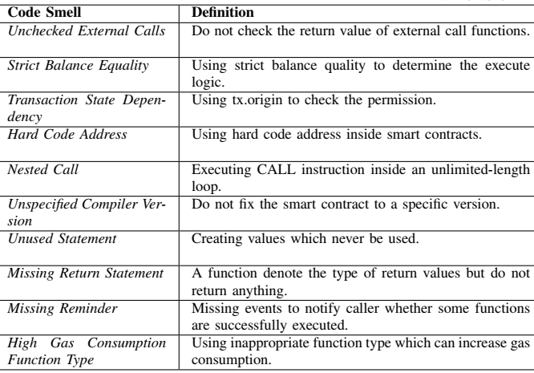
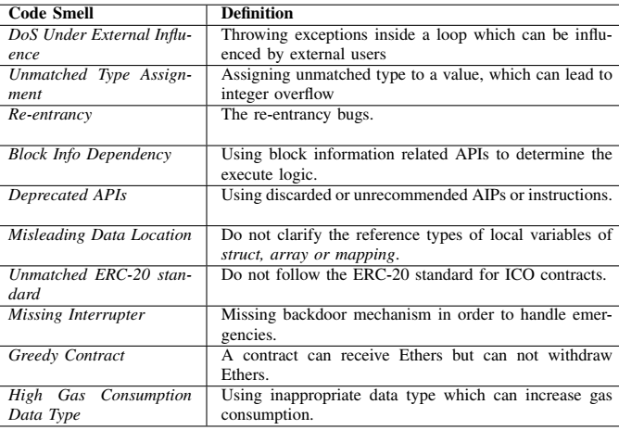
Code Smells^{[1]}
[1] Chen, Jiachi, Xin Xia, David Lo, John Grundy, Daniel Xiapu Luo, and Ting Chen. “Domain Specific Code Smells in Smart Contracts,” arXiv preprint arXiv:1905.01467 (2019).
Notes:
Code smells are symptoms in source code that possibly indicate deeper problems.
Authors manually analysed smart-contract-related posts from Stack Exchange and identified these 20 kinds of code smells.
Those can be categorised as related to security, architecture, and usability problems.
Authors then manually identified defined code smells in 587 contract accounts to validate the code smells.
By checking for code smells we can try to avoid potential bugs & improve the design of our code.
E.g., 1st one checks whether we are validating the return value for an external call. We have already seen this can become a problem when you try to send Ether to some account using a contract.
Other e.g., include the use of hard-coded addresses, address.call used in loops, high gas-consuming functions, and reentrancy.
You should make sure your contract doesn’t have these issues.

Slide 21
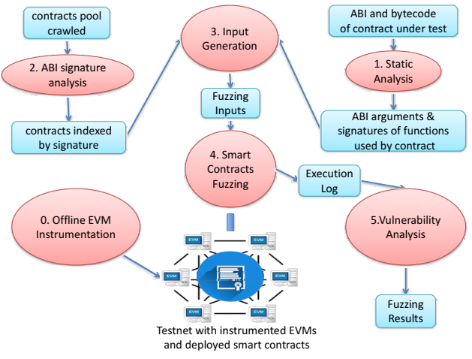
ContractFuzzer^{[2]} – Fuzzing SCs for Vulnerability Detection
Fuzz testing – Automated testing by providing invalid, unexpected, or random data as inputs
Set of test oracles
Gasless address.send
Exception disorder
Reentrancy
Timestamp dependency
Block no dependency
Dangerous delegate calls
Freezing Ether
Critique
+ Dynamic testing
- High rate of false negatives
- Depends on quality of test oracles
[2] Jiang, Bo, Ye Liu, and W. K. Chan. “Contractfuzzer: Fuzzing smart contracts for vulnerability detection,” In Proc. 33rd ACM/IEEE Intl. Conf. on Automated Software Engineering, pp. 259-269. ACM, 2018.
Notes:
Fuzzing or fuzz testing is an automated testing technique that gives invalid or random inputs to a program and then monitors for exceptions such as crashes, failed assertions, or other potential issues.
Groups of such inputs are called test oracles.
ContractFuzzer generates fuzzing inputs based on the ABI specifications of a smart contract to detect security vulnerabilities.
E.g., in a gasless send address.send() is called with value = 0.
In exception disorder, we check whether an exception is propagated through a chain of calls.
Freezing Ether check for cases like calling selfdestruct without returning Ether.
It also uses EVM to log smart contracts’ runtime behaviour and analyses these logs to identify security vulnerabilities.
Authors tested the tool using real smart contracts and found that it works better than Oyente another popular and one of the oldest tools for smart contract testing.
In terms of good and bad the technique:
This is a dynamic testing technique as the code is executed with fuzz inputs.
Some of the negative aspects include high false negatives, which means you can’t detect a vulnerability when it exists.
Also, effectiveness depends on the quality of test oracles.
You also need a modified EVM to capture test data.

Slide 22
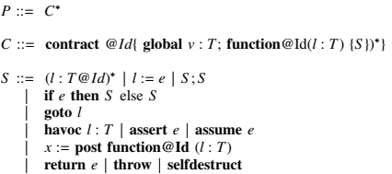
ZEUS – Analysing Safety of Smart Contracts^{[3]}
Automatic formal verification of SCs using abstract interpretation & symbolic model checking
Focuses on
Correctness – Safe programming practices
Fairness – Follow business logic
Technique
Policy builder
Abstract language to model smart contract behaviour
Source code translator
Solidity to LLVM bytecode
Add policy conditions as assert statements
Verifier
Check assertion violations
[3] Kalra, Sukrit et al., “ZEUS: Analyzing Safety of Smart Contracts,” In Network and Distributed Systems Security (NDSS) Symposium, Feb. 2018.
Notes:
ZEUS is a tool by IBM that focuses on automatic formal verification.
ZEUS compare source code against its abstract representation.
It focuses on safe programming practices (correctness) and the correctness of business logic implementation (fairness).
First, you have to define the logic using a policy builder that provides an abstract langue to model smart contract behaviour.
Second, ZEUS translates the source code to an intermediate language called LLVM.
LLVM is a popular intermediate representation of a source code that allows the bytecode to be analysed with existing tools.
Finally, it compares policy conditions as violations of assert conditions in the LLVM code.

Slide 23
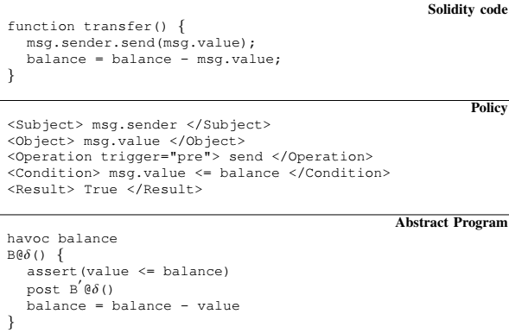
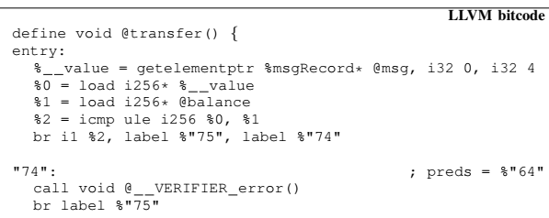
ZEUS (Cont.)
Performance
Tested with 1,524 unique contracts
Found 94.6% of them to be vulnerable
Test within seconds
No false negatives & few false positives
Critique
+ Static testing
- User needs to provide policy document
- Can check only for pre-coded issues
- CPU & memory expensive
- No multi-function/contract testing
Notes:
Here’s an example of a smart contract function, policy defining how it should behave, its abstract specification, and complied LLVM bytecode.
When tested with over 1,500 real-world contract authors found most smart contracts have known issues.
This is a static testing technique as it uses the source code.
The main issue is that a user needs to provide a policy document, based on which we can only check for pre-coded issues.
While the tools runs in seconds, it need multi-code and high memory system.

Slide 24
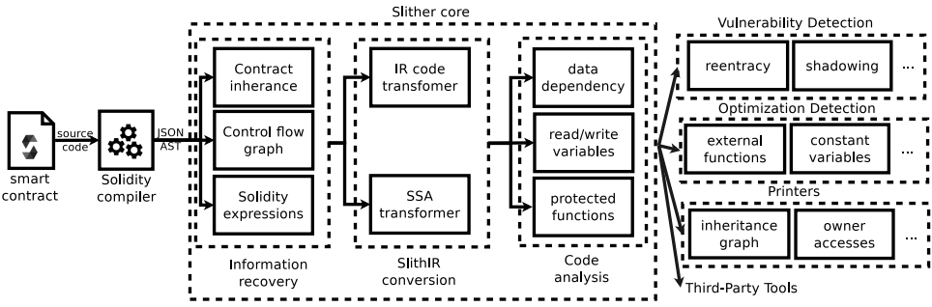
Slither – A Static Analysis Framework for SCs^{[4]}
Use an intermediate representation called Slither
Supports security testing, code optimization, review, & user understanding
[4] Feist, Josselin, Gustavo Grieco, and Alex Groce. “Slither: a static analysis framework for smart contracts,” In 2019 IEEE/ACM 2nd Intl. Workshop on Emerging Trends in Software Engineering for Blockchain (WETSEB), pp. 8-15. IEEE, 2019.
Notes:
Slither is another static analysis tool.
Given a compiled smart contract, it transforms the bytecode and then performs various analyses on the transformed code.
Based on this analysis, Slither can support security testing, code optimization, review, and user understanding.
For e.g., it can check for reentrancy, code optimisations, and provide various visualisations to understand code.

Slide 25
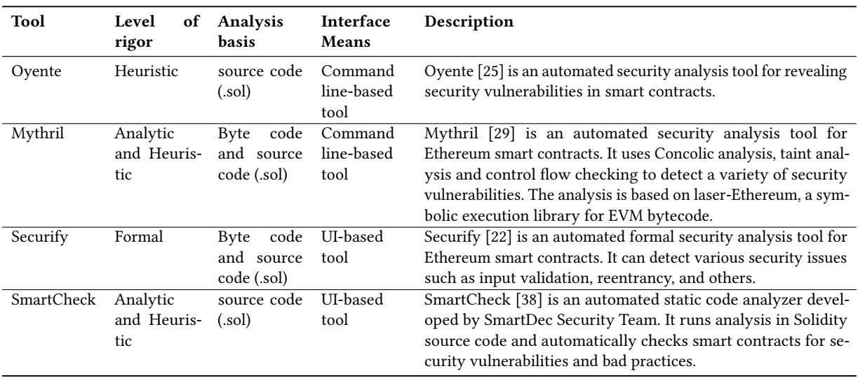
Other Tools^{[5]}
[5] Parizi, Reza M. et al., “Empirical vulnerability analysis of automated smart contracts security testing on blockchains,” In Proc. 28th Annual Intl. Conf. on Computer Science and Software Engineering, pp. 103-113. IBM Corp., 2018.
Notes:
There are several other tools and Oyente and Myrhril are popular
All these are static analysis tools.

Slide 26
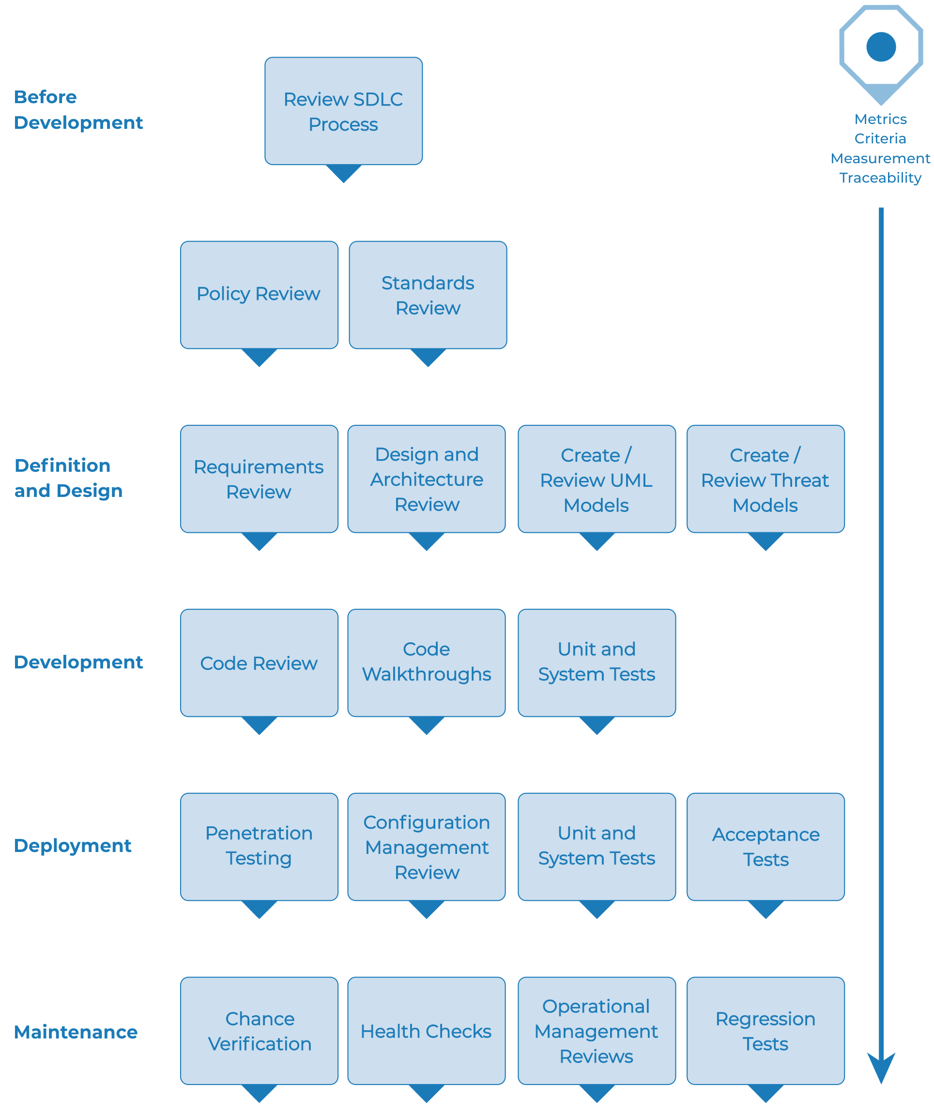
OWASP Testing Framework^{[6]}
Testing throughout SDLC
Manual inspection, threat modelling, code review, penetration testing
Identification of functional & non-functional security requirements
Details are more focused on penetration testing
Extensive set of test cases
Web-application specific
ISO/IEC 27034 cover some of the other aspects
[6] OWASP Testing Guide v4.2, 2020
Notes:
OWASP stands for Open Web Application Security Project.
They provide a testing framework, as well as publish the top 10 vulnerabilities in web applications, mobile apps, and IoT.
OWASP is perhaps the most well-known and used testing framework.
The testing framework applies throughout the SDLC (Software Development Life Cycle) and even how you conduct SDLC.
These are set of actions or tests that you can perform along the SDLC.
There’s some discussion on blockchain-specific OWASP, so maybe we’ll see something in the future.

Slide 27
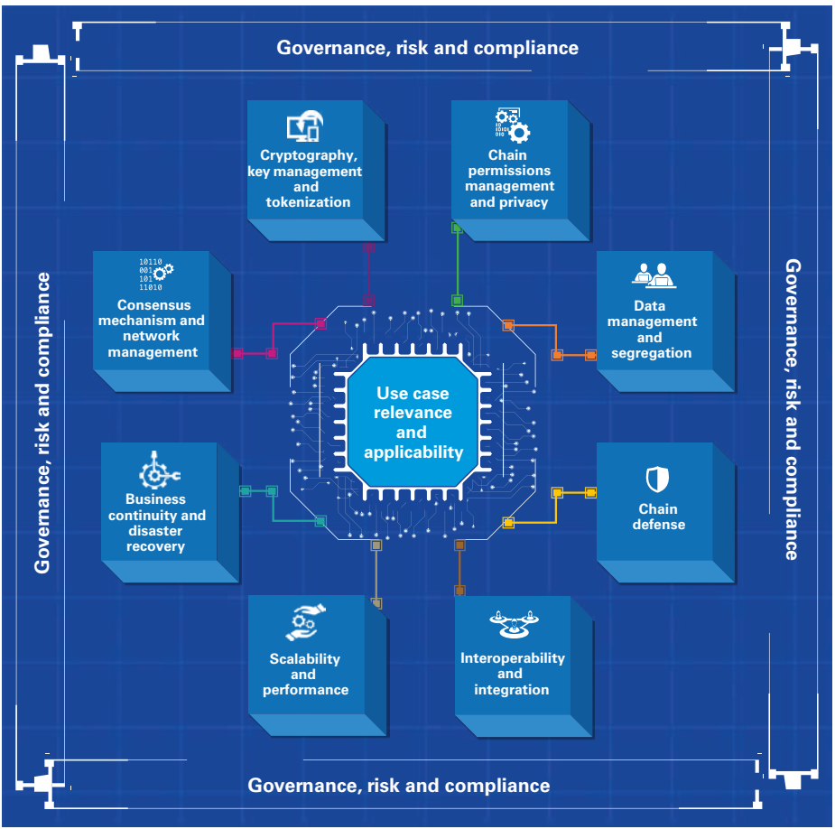
KPMG BC Risk Assessment Framework^{[7]}
Consensus & network management
Security & incentives
Cryptography & Key management
Generation, distribution, use, & revocation
Access control & privacy
Data management
On-chain vs. off-chain
Chain defence
Integration
Scalability & performance
Business continuity & DR
Certificate Authority (CA) & wallets
Governance & compliance
Use case relevancy
[7] KPMG International, Realizing Blockchains Potential, 2018
Notes:
The tools we discussed so far focus only on smart contracts. While it is a key part of the puzzle, we also need to focus on the entire application.
KPMG blockchain risk assessment framework focuses on an entire blockchain-based application in an enterprise setting.
This framework focuses on 8 areas from designing to testing.
Governance and compliance is considered throughout, e.g., especially needed in regulated industries.
All areas are analysed based on their relevance to the use case.

Slide 28
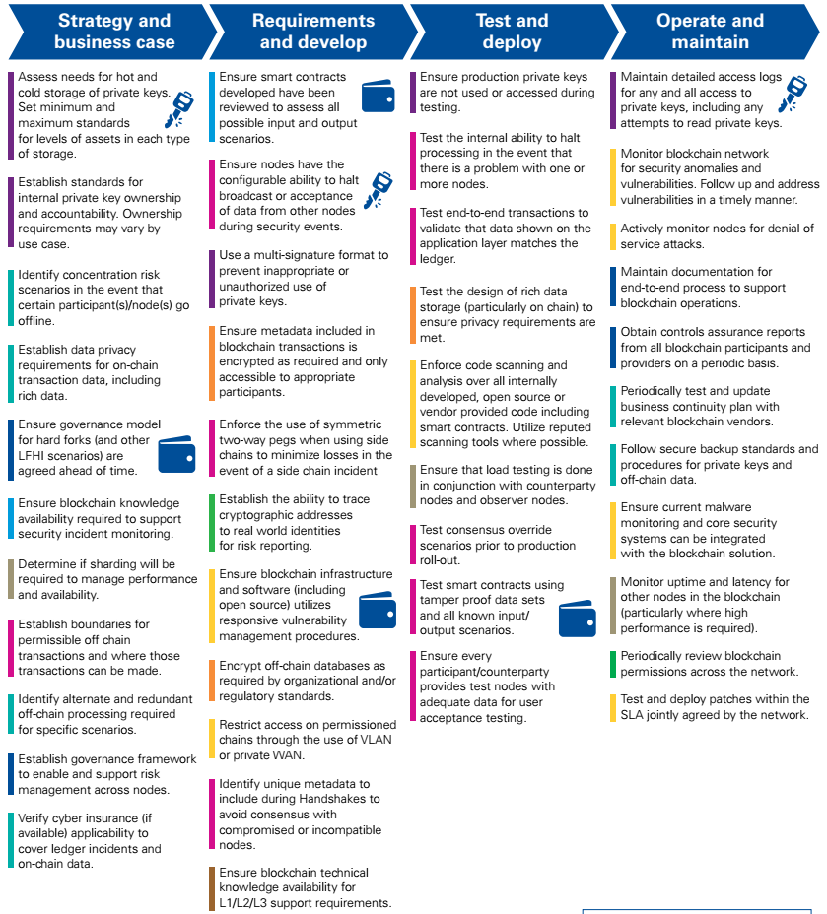
Applying KPMG Framework
[7] KPMG International, Realizing Blockchains Potential, 2018
Notes:
Here we see a bunch of things we need to consider from business case development to development, testing, and operation of a blockchain-based application.
These guidelines are designed for an enterprise setting. You may notice that most of these steps are common to any enterprise application.
There are some specific steps related to blockchains such as consensus, 2-way peg, and blockchain expertise.

Slide 29
Question
Which of the following statement(s) is True?
Code Smells is a form of automated testing that use invalid, unexpected, or random data as inputs.
Both static & dynamic testing are needed.
We can certify a smart contract as secure if at least 2 testing tools didn’t find any vulnerabilities
All tools contain false positives; hence, you need to manually verify whether a vulnerability really exist
X
✓
X
✓
Notes:
Code smells are for programmers to avoid common pitfalls. Providing invalid, unexpected, or random data as inputs is fuzz testing
Both static testing and dynamic testing are needed to enhance the security of an application.
There can be false negatives. Also, no single tool can check for all possible vulnerabilities. More tools are better, but we can’t say 100% secure.
Any tool will contain false positives or positives. So we need to check whether the problem really exists.

